Slide 1
Deep Learning for Computer Vision with TensorFlow
Chandran Venkatesan 2019-09-23
NVIDIA Certified Instructor

Slide 2
Preliminary
Machine Learning
Deep Learning
Linear Algebra
Python (numpy)

Slide 3
Throughout the Slides
Please put following codes to run our sample codes.
import numpy as np import tensorflow as tf
All codes are written in python 3.x and TensorFlow 1.x.
We tested codes in Jupyter Notebook.

Slide 4
What is TensorFlow?

Slide 5
What is TensorFlow?
TensorFlow was originally developed by researchers and engineers working on the Google Brain Team.
TensorFlow is an open source software library for numerical computation using data flow graphs.
It deploys computation to one or more CPUs or GPUs in a desktop, server, or mobile device with a single API.

Slide 6
TensorFlow Architecture
Core in C++
Very low overhead
Different front ends for specifying/driving the computation
Python and C++ today, easy to add more
Python
C++
...
TensorFlow core execution language
CPU
GPU
Android
iOS
...
https://www.slideshare.net/JenAman/large-scale-deep-learning-with-tensorflow

Slide 7
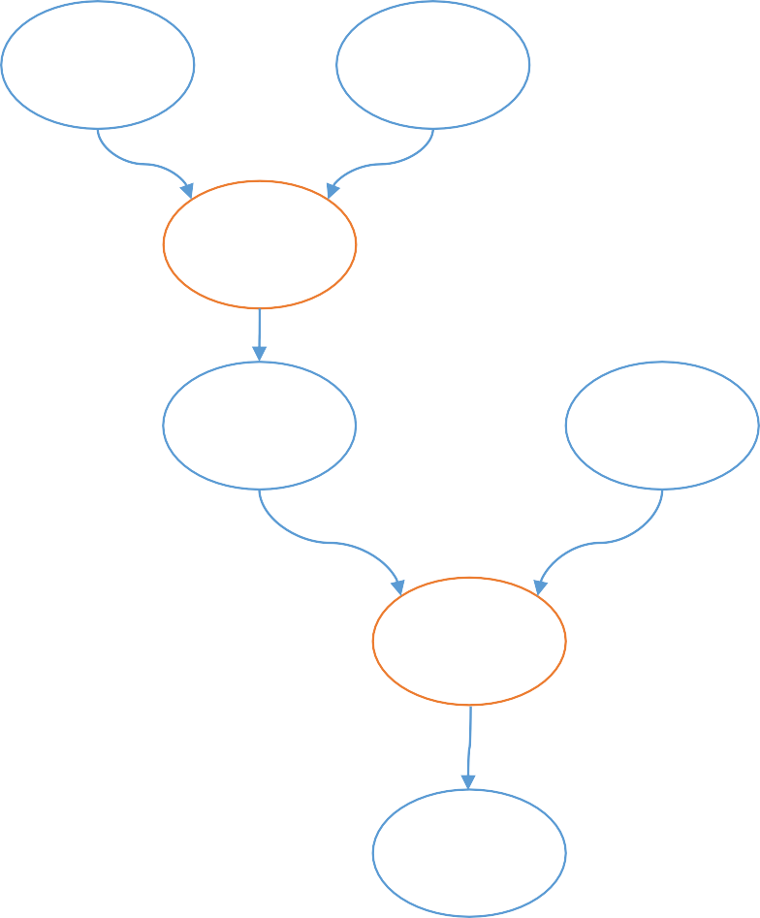
Graphs in TensorFlow
a
b
Computation is a dataflow graph.
A variable is defined as a symbol.
×
x
c
a = tf.Variable(3) b = tf.Variable(2) c = tf.Variable(1) x = a*b
y = x + c
+
y

Slide 8
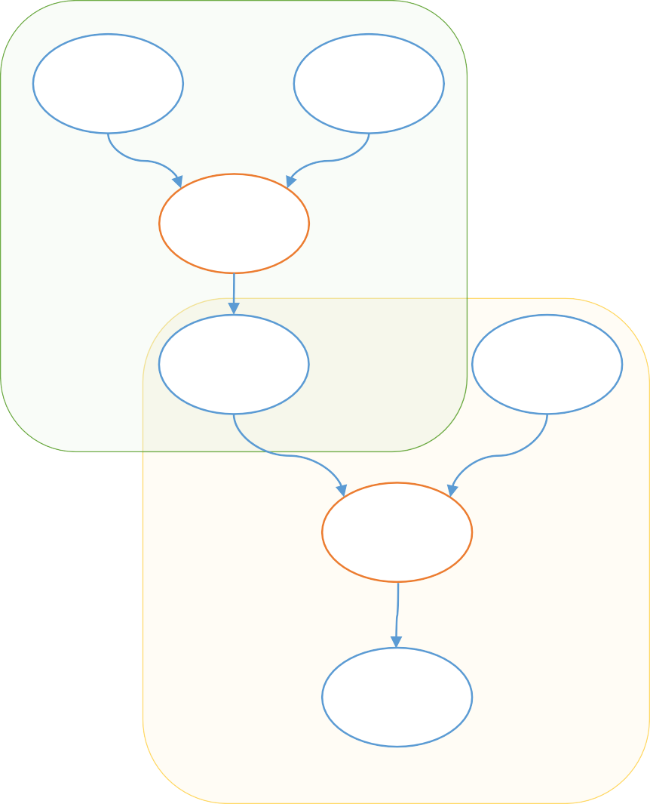
Device Placement
a
b
A variable or operator can be pinned to a particular device.
# Pin a variable to CPU. with tf.device("/cpu:0"):
a = tf.Variable(3) b = tf.Variable(2) x = a*b
CPU
×
x
c
+
GPU
# Pin a variable to GPU.
with tf.device("/gpu:0"): c = tf.Variable(1)
y = x + c
y

Slide 9
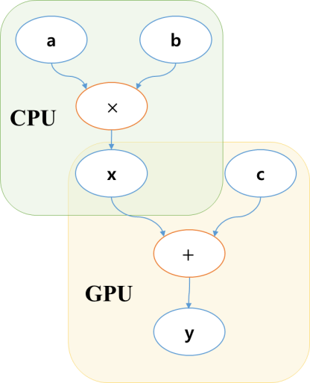
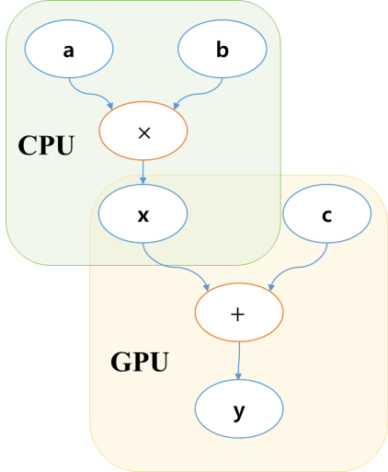
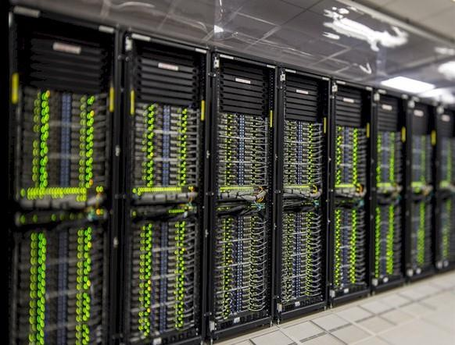


Distributed Systems of GPUs and CPUs

Slide 10
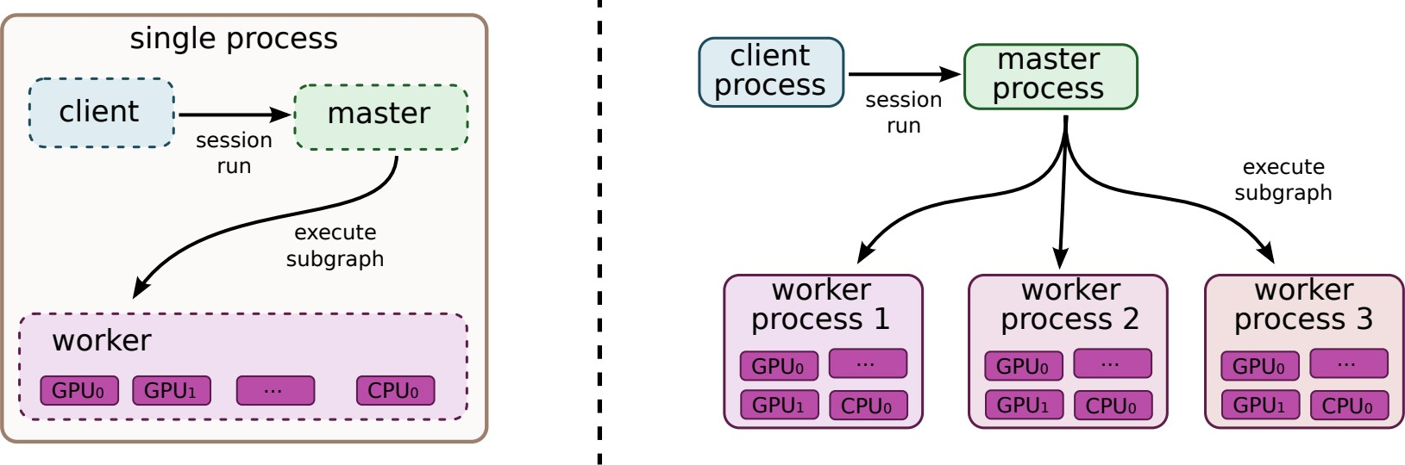
TensorFlow in Distributed Systems
http://download.tensorflow.org/paper/whitepaper2015.pdf

Slide 11
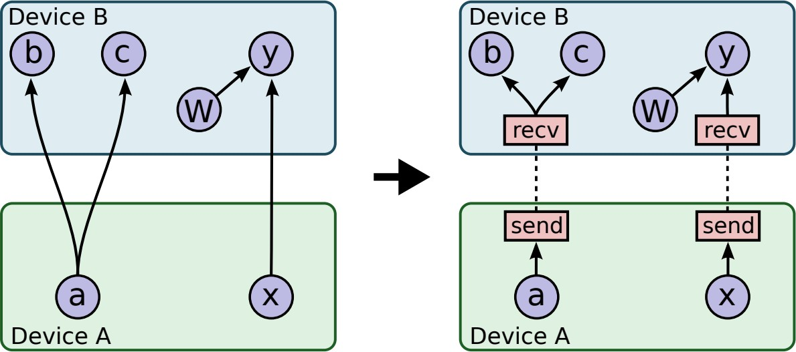
TensorFlow in Distributed Systems cont.
http://download.tensorflow.org/paper/whitepaper2015.pdf

Slide 12
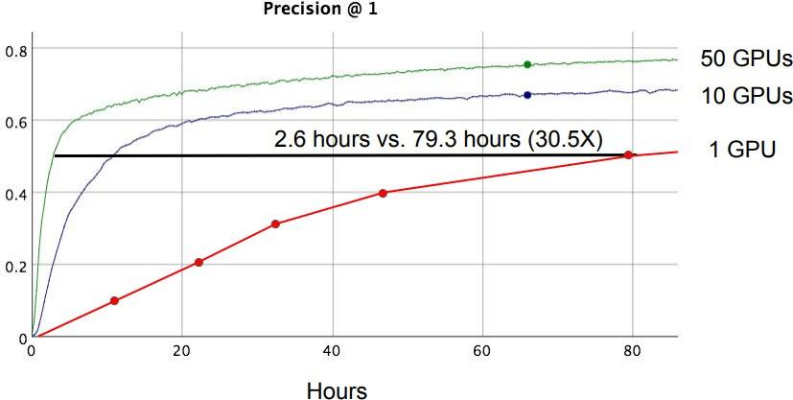
Image Model Training Time
https://www.slideshare.net/JenAman/large-scale-deep-learning-with-tensorflow

Slide 13
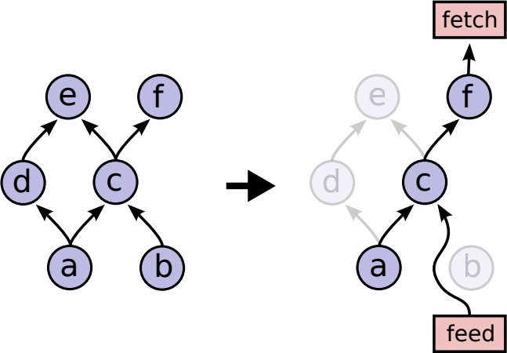
Partial Flow
TensorFlow executes a subgraph of the whole graph.
We do not need “e” and “d” to compute “f”.
http://download.tensorflow.org/paper/whitepaper2015.pdf

Slide 14
Graph Optimizations
Common Subexpression Elimination
Controlling Data Communication and Memory Usage
Asynchronous Kernels
Optimized Libraries for Kernel Implementations
BLAS, cuBLAS, GPU, cuda-convnet, cuDNN
Lossy Compression
32 → 16 → 32bit conversion

Slide 15
What is Tensor?

Slide 16
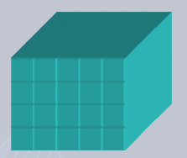
Tensor
A tensor is a multidimensional data array.
Order | 0 | 1 | 2 | 3
 | Scalar | Vector | Matrix | Cube?
 | 100 | 5, 3, 7, … , 10 | 1 2 3 1

Slide 17
Shape of Tensor
List of dimensions for each order.
Shape = [4, 5, 2]
V = tf.Variable(tf.zeros([4, 5, 2]))

Slide 18
Reshape
V = tf.Variable(tf.zeros([4, 5, 2]))
W = tf.reshape(V, [4, 10])
Reshapes the tensor.

Slide 19
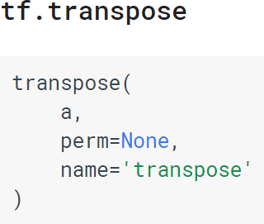
Transpose
a = np.arange(2*3*4) x = tf.Variable(a)
x = tf.reshape(x, [2, 3, 4])
y1 = tf.transpose(x, [0, 2, 1])
y2 = tf.transpose(x, [2, 0, 1])
y3 = tf.transpose(x, [1, 2, 0])
print(y1.get_shape()) # (2,4,3)
print(y2.get_shape()) # (4,2,3)
print(y3.get_shape()) # (3,4,2)
Transposes tensors.
Permutes the dimensions.

Slide 20
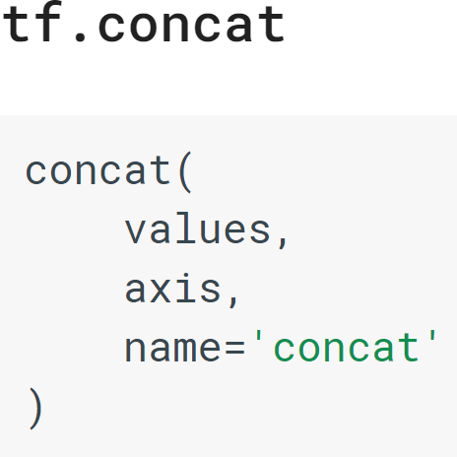
Concatenation
Concatenate two or more tensors.
# tensor t1 with shape [2, 3]
# tensor t2 with shape [2, 3]
t3 = tf.concat([t1, t2], 0) # ==> [4, 3]
t4 = tf.concat([t1, t2], 1) # ==> [2, 6]
axis=1
axis=0

Slide 21
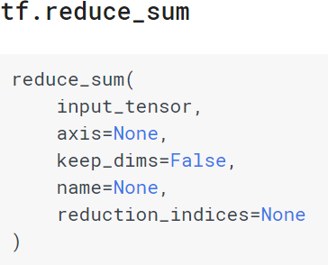
Reduce Operations
Computes an operation over elements across dimensions of a tensor.
tf.reduce_sum(…), tf.reduce_prod(…), tf.reduce_max(…), tf.reduce_min(…)
# 'x' is [[1, 1, 1]
# [1, 1, 1]]
tf.reduce_sum(x) # ==> 6 tf.reduce_sum(x, 0) # ==> [2, 2, 2]
tf.reduce_sum(x, 1) # ==> [3, 3]
tf.reduce_sum(x, 1, keep_dims=True) # ==> [[3], [3]]
tf.reduce_sum(x, [0, 1]) # ==> 6

Slide 22
Matrix Multiplication
Matrix multiplication with two tensors of order 2.
# 2-D tensor `a`
a = tf.constant([1, 2, 3, 4, 5, 6], shape=[2, 3]) # => [[1. 2. 3.]
[4. 5. 6.]]
# 2-D tensor `b`
b = tf.constant([7, 8, 9, 10, 11, 12], shape=[3, 2]) # => [[7. 8.]
[9. 10.]
[11. 12.]]
c = tf.matmul(a, b) # => [[58 64]
[139 154]]

Slide 23



Broadcasting
Broadcasting is the process of making arrays with different shapes have compatible shapes for arithmetic operations.
This is similar to that of numpy
Adding a vector to a matrix.
Adding a scalar to a matrix

Slide 24
Gradients
Constructs symbolic partial derivatives.
# Build a graph.
x = tf.placeholder(tf.float32, shape=()) y = x*x + tf.sin(x)
g = tf.gradients(y, x) # 2*x + cos(x)
# Launch the graph in a session. sess = tf.Session()
# Evaluate the tensor `g`. print(sess.run(g, {x:0.0})) # 1.0 print(sess.run(g, {x:np.pi})) # 5.2831855

Slide 25
Variables
Variables are in-memory buffers containing tensors.
All variables have names.
If you do not give a name, then unique name will be automatically assigned.
# Various ways to create variables.
x = tf.Variable(tf.zeros([200]), name="x")
y = tf.Variable([[1, 0], [0, 1]]) # identity matrix
z = tf.constant(6.0) # this is also a variable that does not change!
learning_rate = tf.Variable(0.01, trainable=False) # not trainable!

Slide 26
Initialization of Variables and Session
Variables initializer must be called before other ops in your model can be run.
A session encapsulates the control and state of the TensorFlow runtime.
A graph is created and allocated in memory when the session is created.
...
# Add an op to initialize the variables.
init_op = tf.global_variables_initializer()
# Later, when launching the model with tf.Session() as sess:
# Run the init operation. sess.run(init_op)
# Use the model
…

Slide 27
sess.run()
Runs operations and evaluates tensors.
You may feed values to specific variables in the graph.
# Build a graph.
a = tf.constant(5.0) b = tf.constant(6.0) c = a * b
# Launch the graph in a session. sess = tf.Session()
# Evaluate the tensor `c`. print(sess.run(c)) # 30.0 print(sess.run(c, {b:3.0})) # 15.0
print(sess.run(c, {a:1.0, b:2.0})) # 2.0
print(sess.run(c, {c:100.0})) # 100.0

Slide 28
Placeholders
Inserts a placeholder for a variable that will be always fed.
Pass type and shape for the placeholders.
# Build a graph.
a = tf.placeholder(tf.float32, shape=()) # scalar tensor b = tf.constant(6.0)
c = a * b
# Launch the graph in a session. sess = tf.Session()
# Evaluate the tensor `c`. print(sess.run(c)) # error ! print(sess.run(c, {b:3.0})) # error !
print(sess.run(c, {a:2.0})) # 12.0

Slide 29
Variable Update
Variables can be updated through assign(…) function.
# Build a graph.
x = tf.Variable(100) assign_op = x.assign(x - 1)
# Launch the graph in a session. sess = tf.Session()
# Run assign_op sess.run(tf.global_variables_initializer()) print(sess.run(assign_op)) # 99
print(sess.run(assign_op)) # 98
print(sess.run(assign_op)) # 97

Slide 30
Problems with Variables
Sometimes we want to reuse same set of variables.
Whenever Variable is called it only creates new variable.
How can we reuse same variable?
# define function
def f(x):
b = tf.Variable(tf.random_normal([10], stddev=1.0)) return x + b
…
y1 = f(x1)
y2 = f(x2) # it use different ‘b’ variable

Slide 31
Sharing Variables: tf.get_variable()
The function tf.get_variable() is used to get or create a variable instead of a direct call to tf.Variable.
# define function def f(x):
b = tf.get_variable(‘b’, [10], initializer=tf.random_normal_initializer())
return x + b
…
with tf.variable_scope(“bias") as scope:
y1 = f(x1) scope.reuse_variables()
y2 = f(x2) # it use same ‘b’ variable

Slide 32
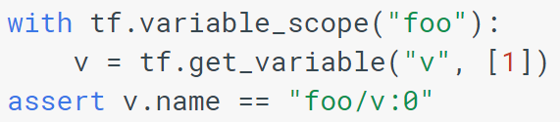
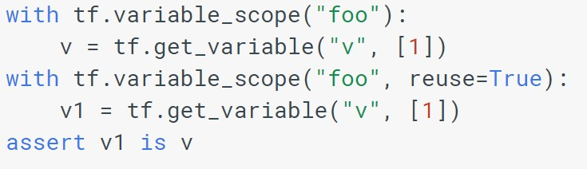
How Does Variable Scope Work?
Variable scope wraps variables with a namespace.
Reusing variables is only valid within the scope.

Slide 33
Caution: Name Duplication
Calling tf.get_variable() twice with same name when reuse is off, invokes error.
b1 = tf.get_variable(‘b’, [10], initializer=tf.random_normal_initializer())
b2 = tf.get_variable(‘b’, [10], initializer=tf.random_normal_initializer()) # error!
ValueError: Variable b already exists, disallowed. Did you mean to set reuse=True in VarScope?
Originally defined at:

Slide 34
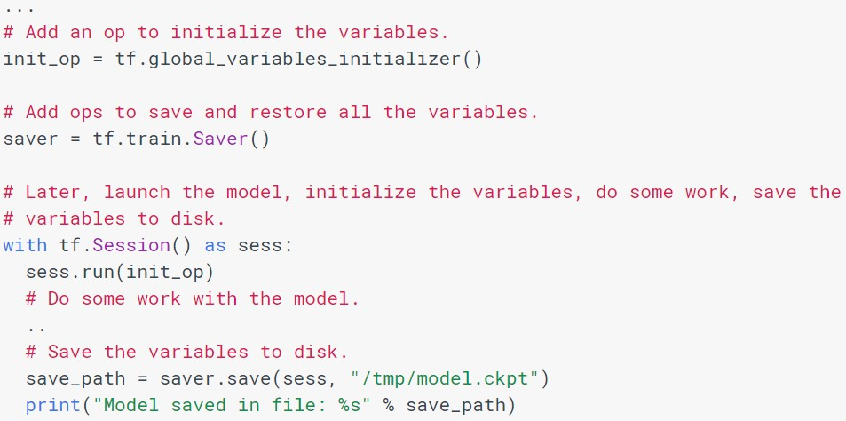
Saving Variables
Call tf.train.Saver() to manage all variables in the model.

Slide 35
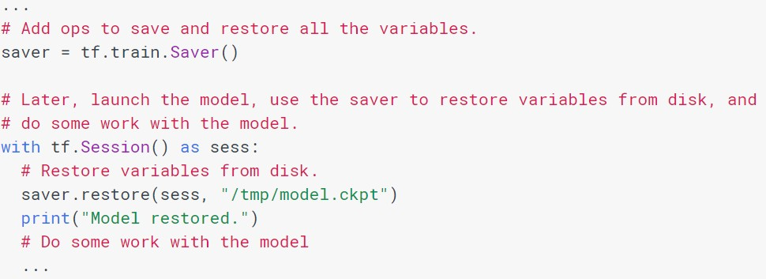
Restoring Variables
The same Saver object is used to restore variables.

Slide 36
Convolutional Neural Network in TensorFlow

Slide 37
Four Main Components in Machine Learning
Hypothesis space
Objective function
Optimization algorithm
Data

Slide 38





Convolution Operations: conv1d, 2d, 3d
TensorFlow provides convolution operations.
conv1d
conv2d
conv3d

Slide 39
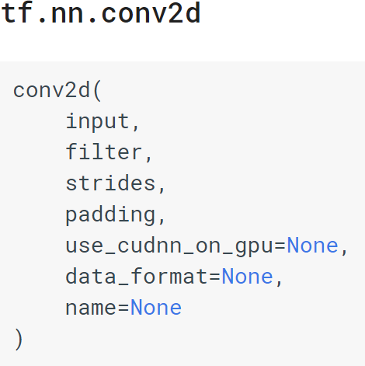
tf.nn.conv2d()
Computes a 2-D convolution given 4-D input and filter tensors.
Input is 4-D tensor.
shape=(batch_size, height, width, channels)
Filter is 4-D tensor.
shape=(filter_height, filter_width, in_channels, out_channels)
Stride is a size of the sliding window for each dimension of input.

Slide 40
tf.nn.conv2d() Padding
padding = “VALID”
Do not use zero padding.
Size of filter map shrinks.
out_height = ceil((in_height - filter_height + 1) / strides[1])
out_width = ceil((in_width - filter_width + 1) / strides[2])
padding = “SAME”
Tries to pad zeros evenly left and right to preserve width and height.
If the amount of columns to be added is odd, it will add the extra column to the right.
out_height = ceil(in_height / strides[1])
out_width = ceil(in_width / strides[2])

Slide 41
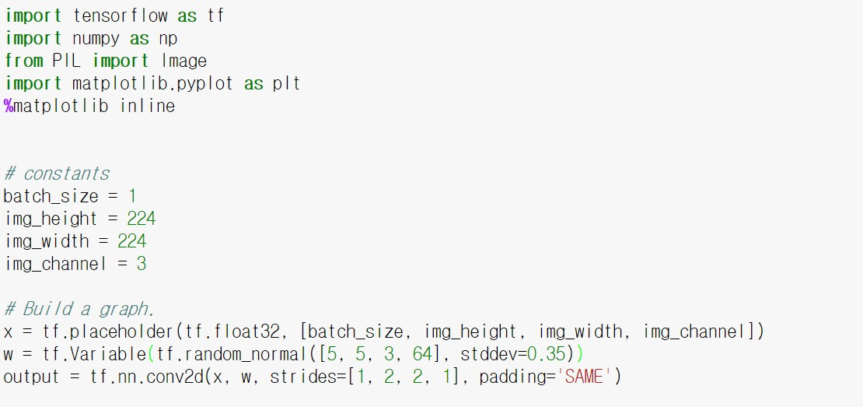
tf.nn.conv2d() Example

Slide 42
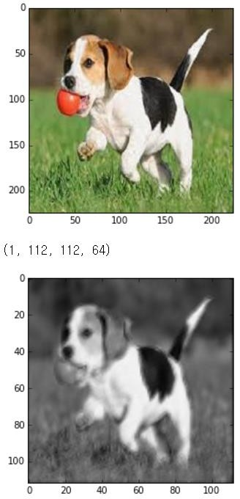
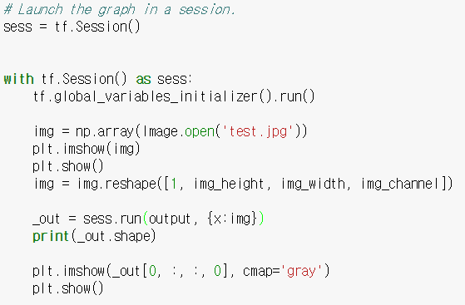
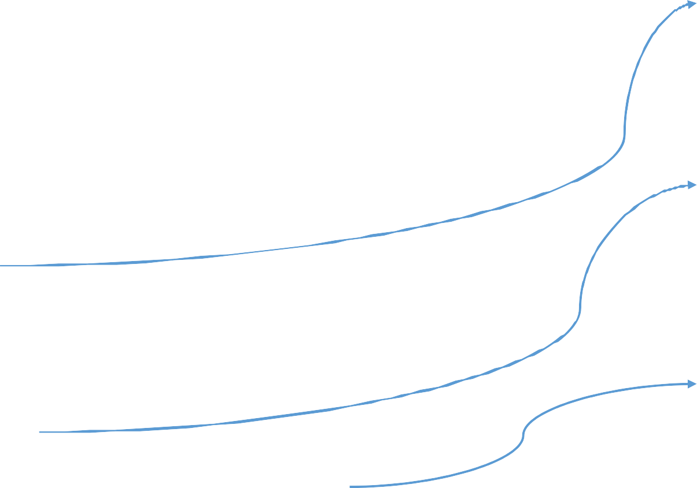
tf.nn.conv2d() Example cont.
Original image
Gray image from the first
channel of the output

Slide 43
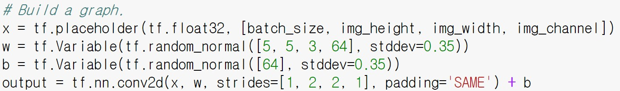
Adding Bias After tf.nn.conv2d()
To enhance representation power of CNN, it is nice to add bias to the output.
Broadcasting addition

Slide 44
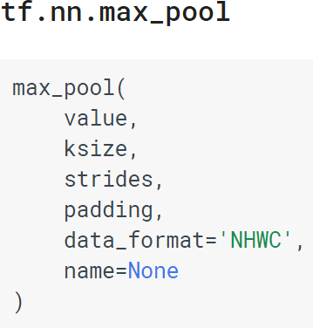
Max Pooling
Performs the max pooling on the input.
‘ksize’
The size of the window for each dimension of the input tensor.
For 2ⅹ2 pooling, ksize = [1, 2, 2, 1]
‘strides’ and ‘padding’ are same as those in
the tf.nn.conv2d().
We can use convolution of stride 2, instead of using max pooling without significant loss of performance.
Check “Springenberg, J. T. et al., (2014).”

Slide 45
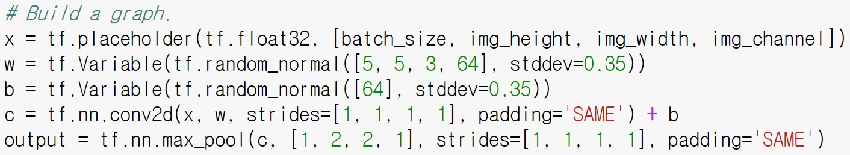
Max Pooling Example
Example of 2ⅹ2 max pooling.

Slide 46
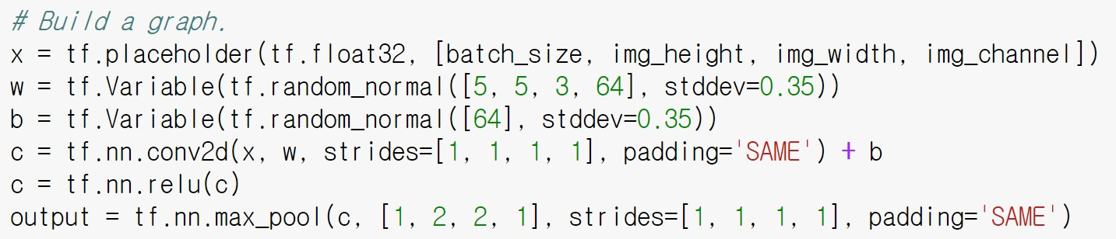
Activation Functions
TensorFlow provides most of the popular activation functions.
tf.nn.relu, tf.nn.softmax, tf.nn.sigmoid, tf.nn.elu, ...
Example of using rectified linear function.

Slide 47
Fully Connected (Dense) Layer
Fully connected (fc) layer can be implemented by calling tf.matmul() function.
y = tf.matmul(x, W)
To compute fc layer after convolution operation, we need to reshape 4-D tensor to 2-D tensor.
[batch_size, height, width, channel]
→ [batch_size, height*width*channel]

Slide 48
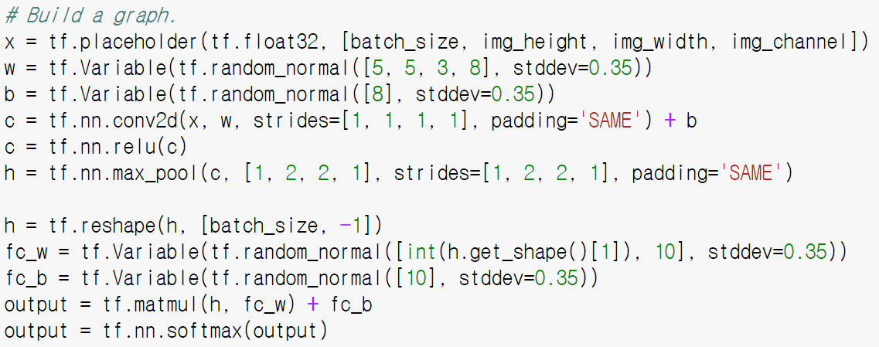
Fully Connected Layer Example

Slide 49
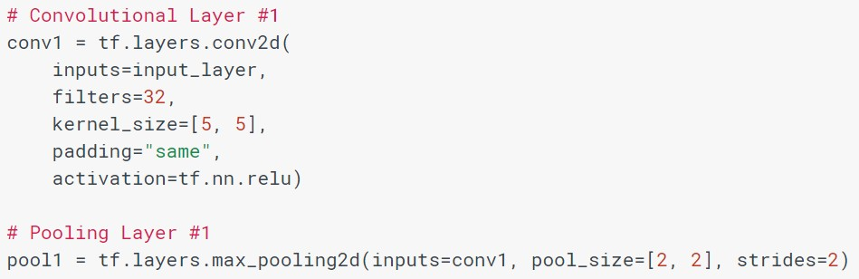
TF Layers: High-level API
The TensorFlow layers module provides a high-level API that makes it easy to construct a neural network.
No explicit weight (filter) variable creation.
Includes activation function in one API.

Slide 50
Other High-level API
TF Slim
TF Learn
Keras (with TensorFlow backend)
Tensor2Tensor

Slide 51
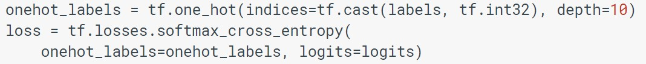
Loss Functions
TensorFlow provides various loss functions.
tf.nn.softmax_cross_entropy_with_logits, tf.nn.l2_loss, ...
TF Layers also provides similar functions starting with tf.losses.
Example of tf.losses.softmax_cross_entropy.
Full codes are in https://www.tensorflow.org/tutorials/layers

Slide 52
Optimizers
TensorFlow provides popular optimizers.
Adam, AdaGrad, RMSProp, SGD, ...
Example of plain gradient descent optimizer.
Parameters are updated when sess.run(train_op, ...) is called.
# optimizer learning_rate = 0.01
optimizer = tf.train.GradientDescentOptimizer(learning_rate) train_op = optimizer.minimize(loss)
...
sess.run(train_op, {x: batch_x, y: batch_y})

Slide 53
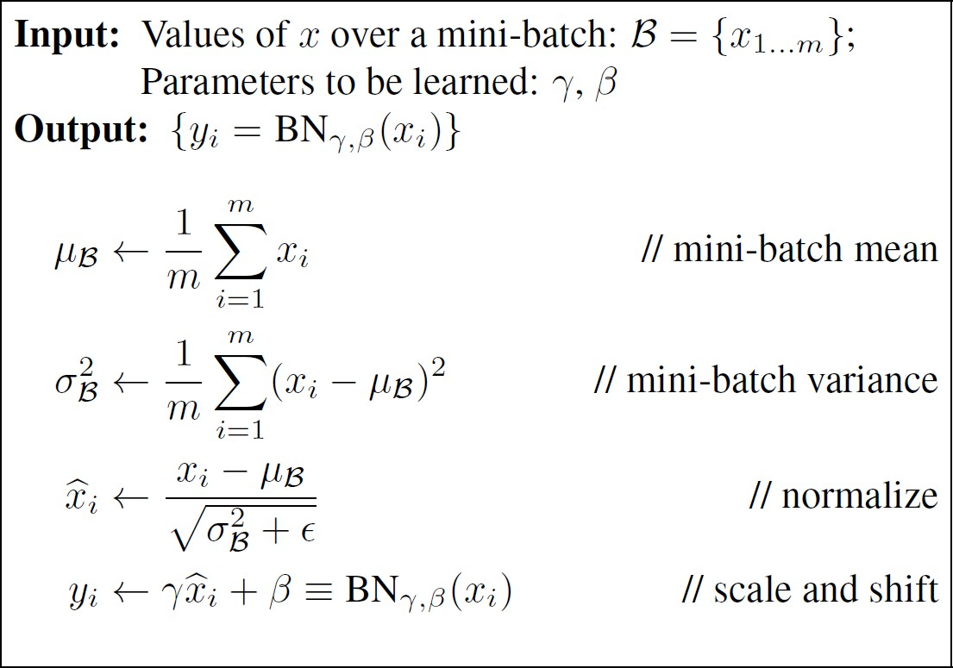
Review of the Batch Normalization
Normalize the activations of the previous layer.
Advantages
Allows much higher learning
rates.
Can be less careful about initialization.
Faster learning.
No need for Dropout.

Slide 54
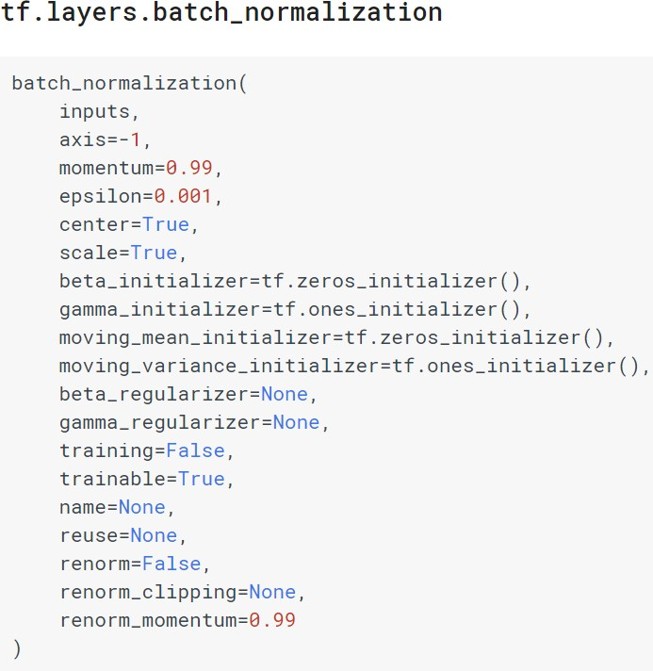
Batch Normalization
tf.nn.batch_normalization() needs bunch of variables and does not support moving statistics, nor inference mode.
Use tf.layers.batch_normalization()
Put training=False, when inference mode.
It supports moving statistics of the mean and variance.
‘momentum’ determines forget rate of the moving statistics.

Slide 55
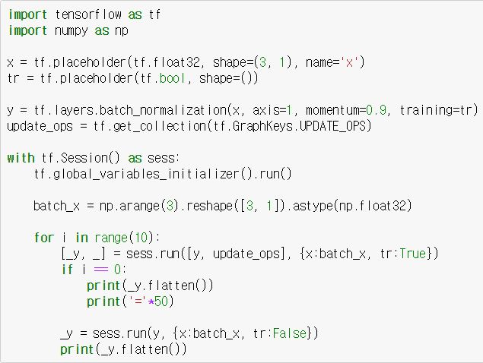
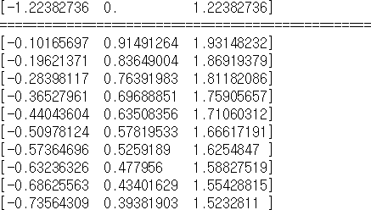
tf.layers.batch_normalization
‘update_ops’ should be called to update statistics of batch normalization.
In inference mode, the values are normalized by moving statistics.

Slide 56
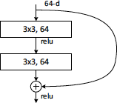
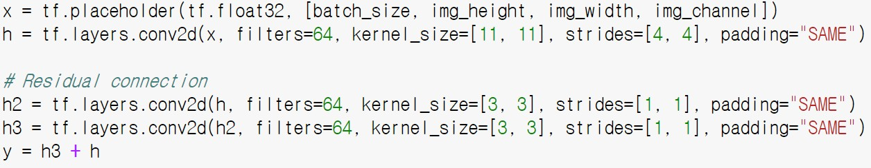
Residual Connection
A Residual Network is a neural network architecture which solves the problem of vanishing gradients.
Residual connection: 𝑦 = 𝑓 𝑥 + 𝑥

Slide 57
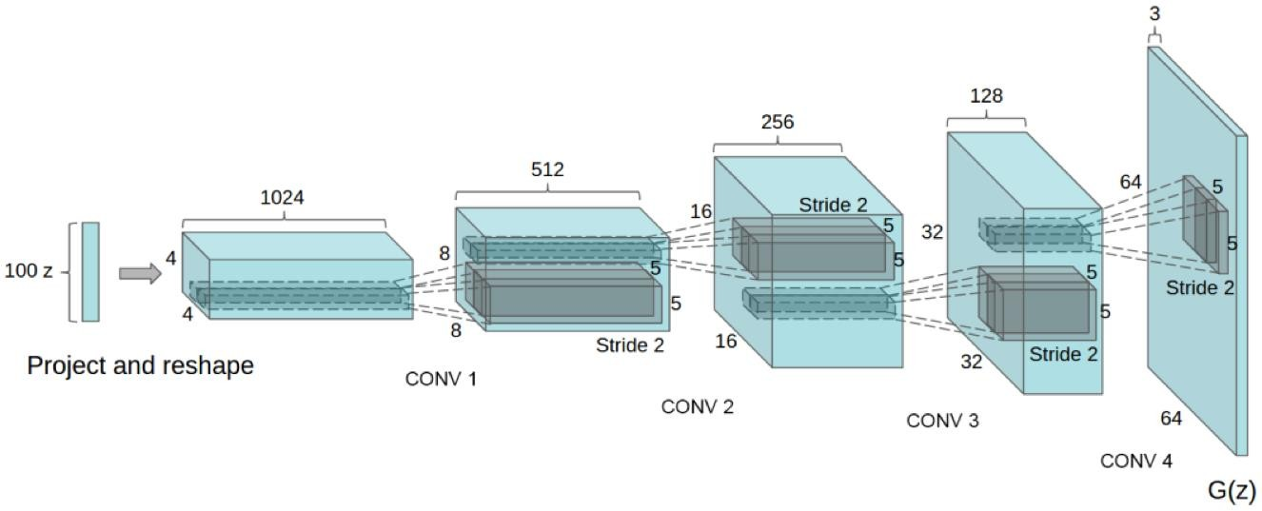
Transposed Convolution (Deconvolution)
The need for transposed convolutions generally arises from the desire to use a transformation going in the opposite direction of a normal convolution.
tf.layers.conv2d_transpose()

Slide 58
Load Pre-trained Models
There are popular network architectures in TF Slim
https://github.com/tensorflow/models/tree/master/slim
Inception V1-V4
Inception-ResNet-v2
ResNet 50/101/152
VGG 16/19
MobileNet

Slide 59
Thank You

Slide 60
References
https://www.tensorflow.org
https://www.slideshare.net/JenAman/large-scale-deep- learning-with-tensorflow
https://www.slideshare.net/AndrewBabiy2/tensorflow- example-for-ai-ukraine2016
http://download.tensorflow.org/paper/whitepaper2015.pdf

